Slide 1




Studying Numerical Literacy Across Generations in U.S. Households
Aws Alsaedi¹, Omar Bintalib¹, Prof. Michael Boutros²
¹Kaust Academy, King Abdullah University of Science and Technology, Thuwal, Saudi Arabia²Department of Economics, University of Toronto, Canada

Slide 2
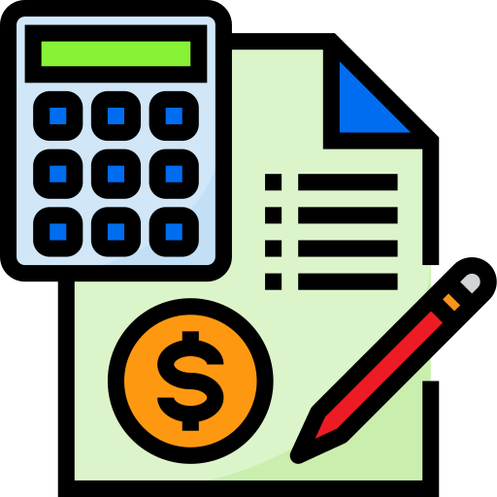
Abstract
Numerical literacy = the ability to understand and work with numbers.
We studied parents and children using national U.S. data (PSID & CDS).
Found modest but real links in number skills across generations.
Families shape both math skills and wealth-building habits.
Early number skills play a role in long-term economic success.
Notes:
Numerical literacy = the ability to understand and work with numbers.
We studied parents and children using national U.S. data (PSID & CDS).
Found modest but real links in number skills across generations.
Families shape both math skills and wealth-building habits.
Early number skills play a role in long-term economic success.

Slide 3

Background / Knowledge Gap
Numerical literacy – financial decision-making, long-term wealth
Research gap – focus mostly on adults, not skill development or transmission
Unknown link – childhood numerical skills → adult outcomes, family wealth
Our contribution – use national PSID & CDS data, multi-generational

Slide 4

Objectives
Persistence – numerical literacy over time (within individuals)
Transmission – from parents to children
Link – childhood skills → adult wealth outcomes
Predictors – intergenerational literacy (statistical & ML methods)

Slide 5

Data
PSID → 6-question numerical literacy test (0–6 score) for parents.
CDS → standardized child assessment (0–120 score) for children.
Why these exams?
Used in past economic research for financial/numerical literacy
Comparable across survey years
Simple and objective scoring

Slide 6
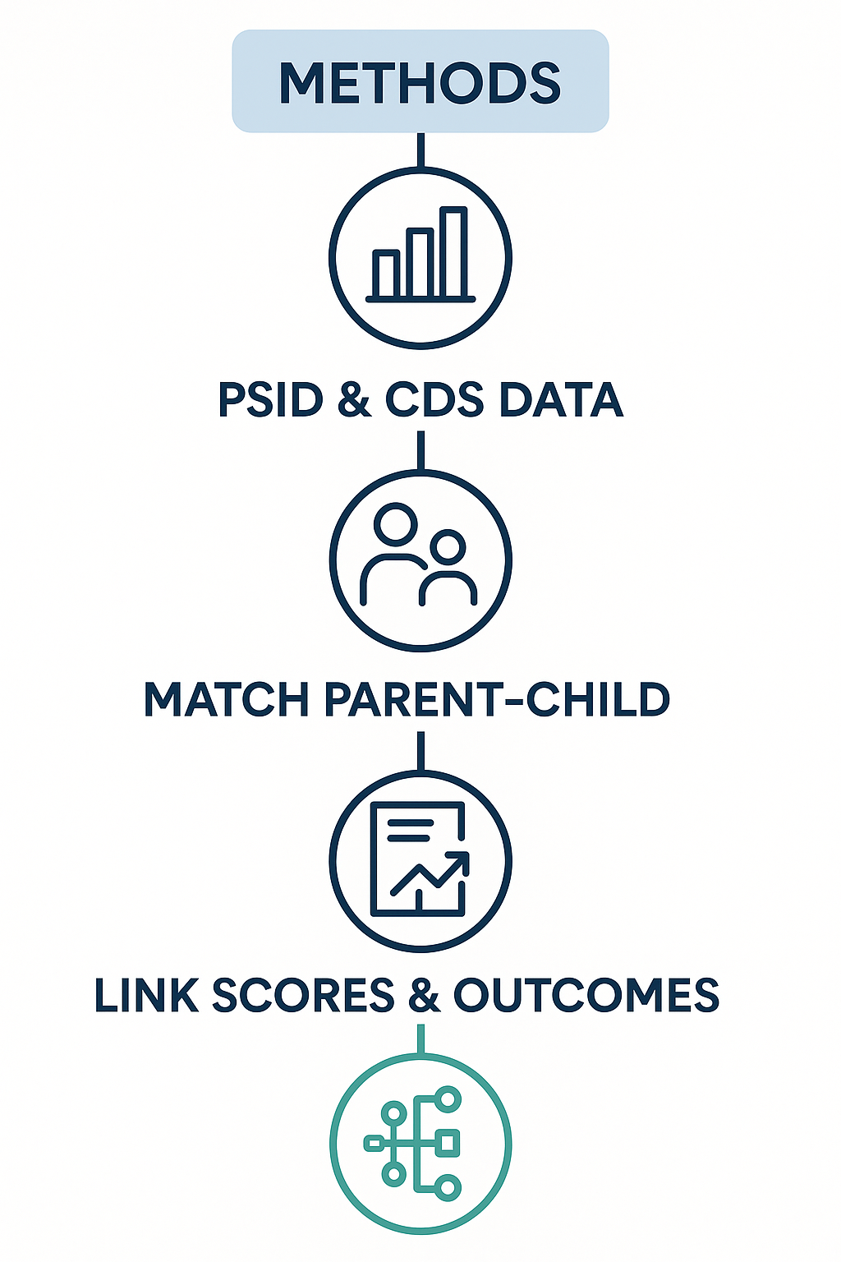
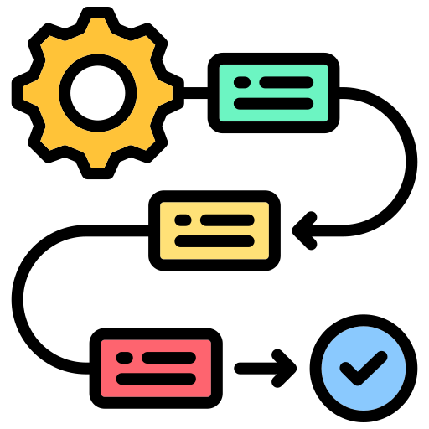
Linked each Child’s test scores with their parents’ test scores and their own future outcomes
Built matched parent–child and matched them over years
Analyzed patterns using both regression models and machine learning

Slide 7
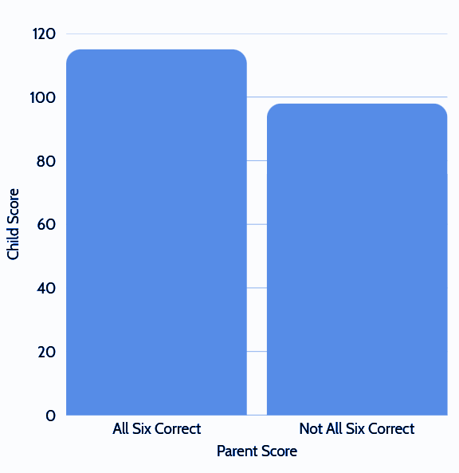
Result 1:
Does numerical literacy persist within an individual?
Yes, the plot shows each person’s average score based on whether they answered all six numerical literacy questions correctly

Slide 8
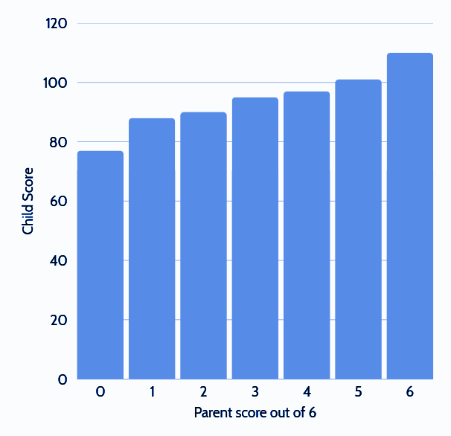
Result 2:
Is it transmitted after generations?
Yes, the higher the parents is score the higher the children.
Thus its transmitted

Slide 9
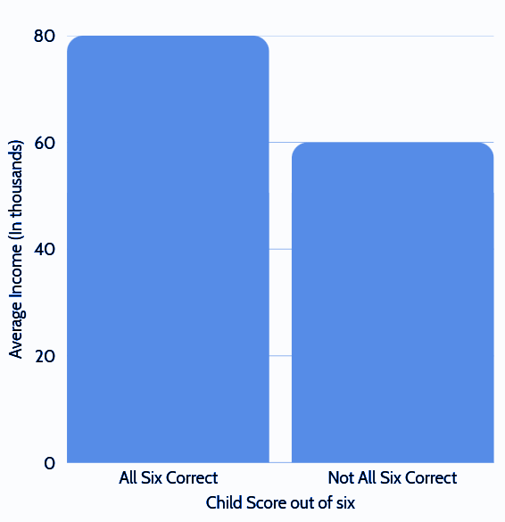
Result 3:
Does numerical literacy have an effect on income
Children who answered all six questions correctly had a much higher income

Slide 10

Discussion
Persistence – numerical literacy over time
Transmission – between generations (family influence)
Early skills → Wealth – importance of early education
Key predictors – parental income, spending patterns, education expectations

Slide 11

Conclusion
Persistence – over time
Transmission – across generations
Wealth link – stronger skills → better outcomes
Key predictors – parental income, spending patterns
Lasting impact – on generational families

Slide 12
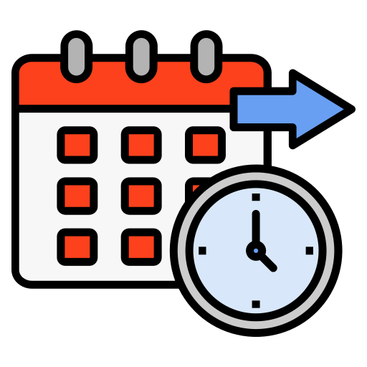
Future Direction
Longer follow-up – more PSID waves
More predictors – for numerical literacy
Richer socioeconomic indicators – occupation, neighborhood
Advanced ML models – improve predictions
Policy strategies – boost early numerical literacy
Cross-country comparison – test generalizability

Slide 13

References
Panel Study of Income Dynamics, public use dataset. Produced and distributed by the University of Michigan, 1968–2021.
Child Development Supplement (CDS) to the PSID, public use dataset. University of Michigan, 1997–2019.
Lusardi, A., Mitchell, O. S., & Curto, V. "Financial literacy and financial sophistication in the older population," Journal of Pension Economics and Finance, vol. 13, no. 4, pp. 347–366, 2014.
Friedman, J. H. "Greedy function approximation: A gradient boosting machine," Annals of Statistics, vol. 29, no. 5, pp. 1189–1232, 2001.

Slide 14

Acknowledgement
We gratefully acknowledge:
Prof. Michael Boutros for guidance and mentorship
Kaust Academy and Dr. Sultan Albarakati for funding and research support
University of Toronto – Data Sciences Institute for resources and collaboration
Our colleagues and peers for valuable feedback

